Slide 1

Animação de Personagens - Boids
Paulo Marques – 25325
Tiago Leite - 25305

Slide 2
Funcionalidades
Separação
Alinhamento
Coesão

Slide 3
Funcionalidades
Lideres
Ponto de Objetivo
Predadores
Caminhos
Obstáculos
Aleatoriedade

Slide 4
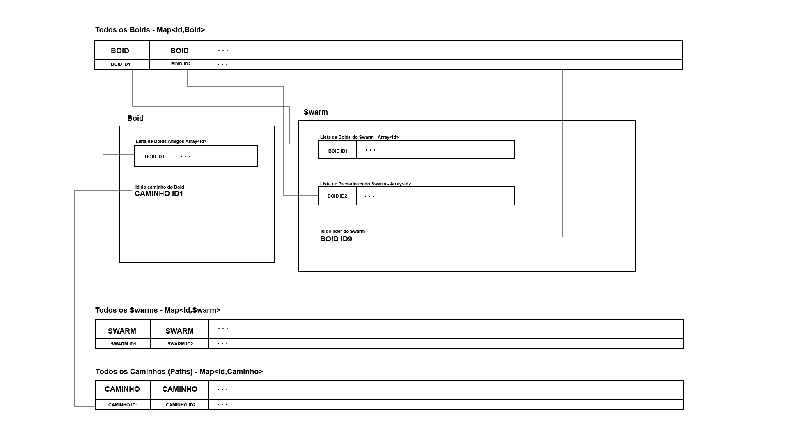
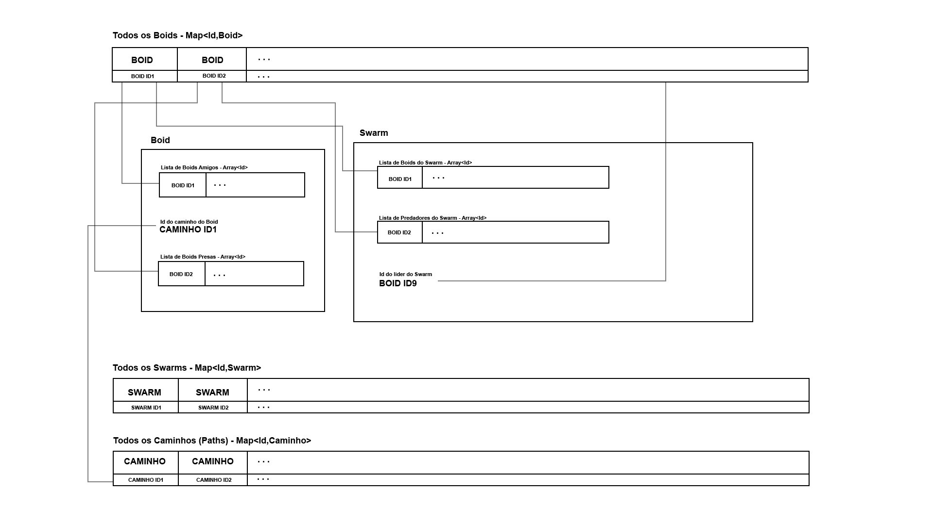
Estrutura

Slide 5
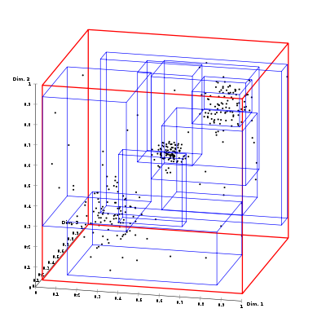
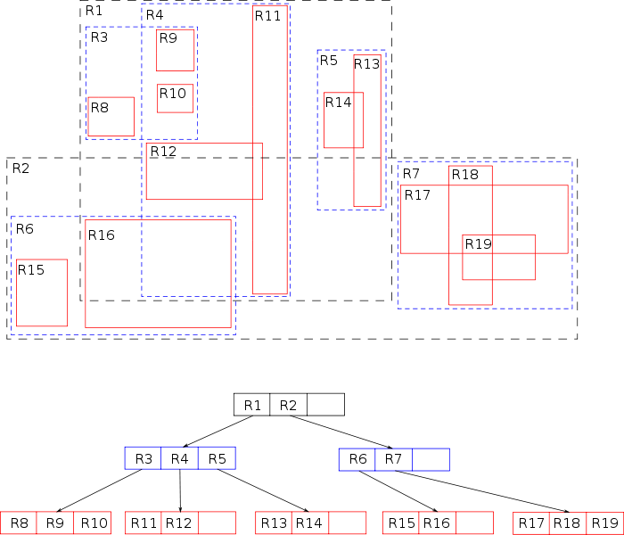
Estrutura - RTree

Slide 6
Linguagem/XML - Boid
<Boid id="id01">
<Attribute velocity="0.2" />
<Attribute acceleration="0.2" />
<Attribute space="10" />
<Attribute sight="20" />
<Attribute steeringDeadZone="0.2" />
<Attribute maxSteeringBySecond="0.2" />
<Attribute boundary="40" />
<Attribute centerOfBoundary="(0.0, 0.0 , 0.0)" />
<Attribute dim="0" />
<Attribute coord2D="0.2" />
<Attribute path_id="0" />
<Attribute property="sou um boid" />
</Boid>

Slide 7
Linguagem/XML - Grupo
<Group id="g01">
<Attribute cycleTime="10" />
<Attribute number="20" />
<Attribute velocity="4.1" />
<Attribute acceleration="0.2" />
<Attribute space="10" />
<Attribute sight="20" />
<Attribute steeringDeadZone="0.2" />
<Attribute maxSteeringBySecond="0.2" />
<Attribute boundary="40" />
<Attribute centerOfBoundary="(0.0, 0.0 , 0.0)" />
<Attribute targetPos="(0.0, 0.0 , 0.0)" />
<Attribute dim="0" />

Slide 8
Linguagem/XML - Grupo
<Attribute coord2D="0.2" />
<Attribute liderId="b05" />
<Attribute predatorId="b34" />
<Attribute predatorsGroup="g02" />
<Attribute add="bobby" />
<Attribute flockWeight="0.5" />
<Attribute disperseWeight="0.5" />
<Attribute matchWeight="0.5" />
<Attribute boundaryWeight="1" />
<Attribute followLiderWeight="1" />
<Attribute followPathWeight="1" />
<Attribute randomWeight="0" />
<Attribute avoidObstaclesWeight="1" />
<Attribute avoidPredatorsWeight="1" />
</Group>

Slide 9
Linguagem/XML - Caminho
<Path id="0">
<Attribute point="( 35.0 , 0.0 , -35.0 )"/>
<Attribute point="( 35.0 , 0.0 , 35.0 )"/>
<Attribute point="( -35.0 , 0.0 , 35.0 )"/>
<Attribute point="( -35.0 , 0.0 , -35.0 )"/>
<Attribute point="( 35.0 , 0.0 , -35.0 )"/>
<Attribute point="( 35.0 , 0.0 , 35.0 )"/>
</Path>

Slide 10
Linguagem/XML - Relação
Unidirecional
Bidirecional
<Friends A="id02" B="id03" />
<Friends A="id02" B="id03" />
<Friends A="id03" B="id02" />

Slide 11
Linguagem/XML - Obstáculos
Cúbicos (Paralelepípedos)
Esféricos
<Obstacle id="2" min="(-10.0 , -10.0 , -10.0)" max="(10.0 , 10.0 , 10.0)" />
<Obstacle id="2" center="(-10.0 , -10.0 , -10.0)" radius="10" />

Slide 12
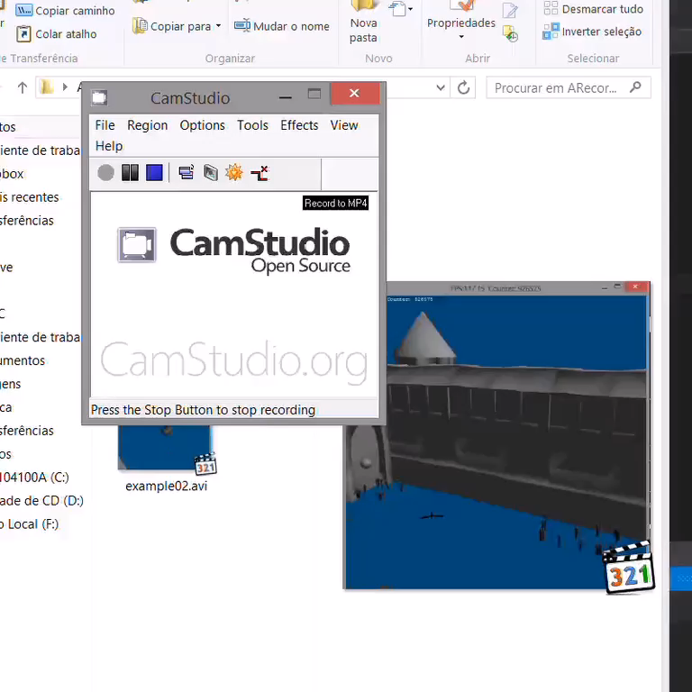

Slide 13
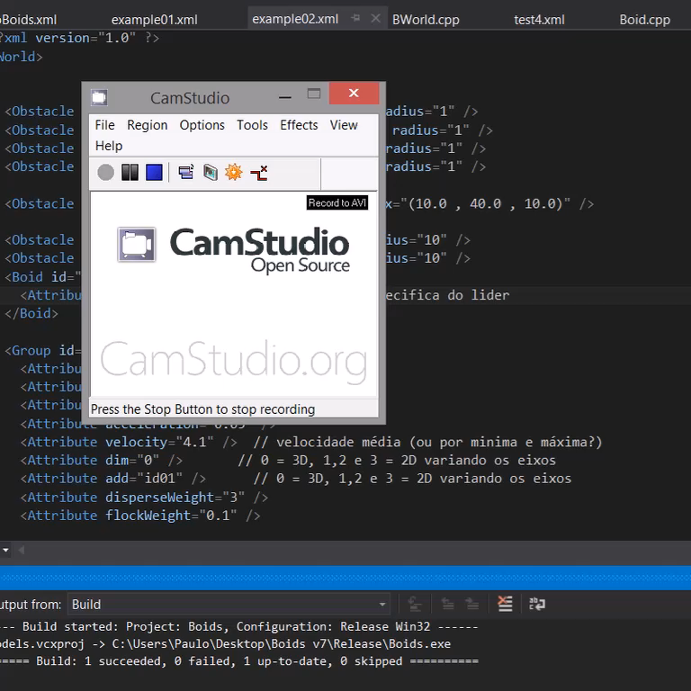

Slide 14
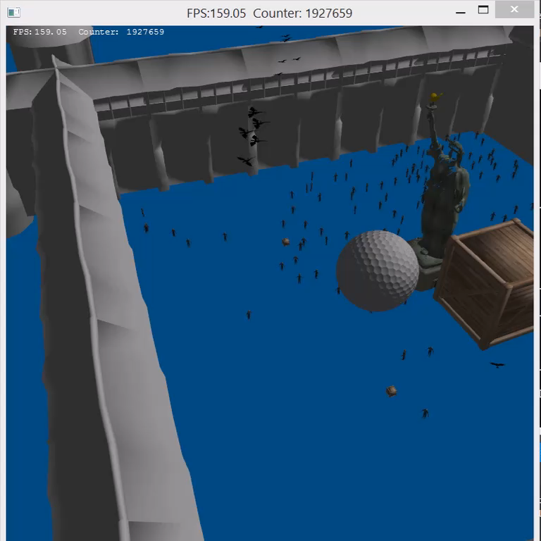

Slide 15
Conclusões

